Slide 1
Basic “need-to-know” for
Anua Puraflo
Bottom draining peat filter systems.
Specific requirements for MN applications.

Slide 2
Peat filter Basics
The Puraflo peat filter is a single pass media filter system, similar in concept to a single pass sand filter.
The typical application is to use the bottom draining pod version to let the treated effluent flow to a drainfield right below the unit.
Another option is to collect the effluent at the bottom of the unit and send it to a lift pump for dispersal elsewhere.
Puraflo peat filters are Minnesota registered to 150 gpd per pod, assuming residential strength waste.
Each of these units will achieve treatment Level “B” without a UV lite.
Treatment level “B” only requires 18” of separation to the seasonal high water table and receives an average 25% reduction of the drainfield size.
Check the “treatment level B” soil loading rates for your specific soil.

Slide 3
System Layout
The basic layout of the bottom draining Peat filter system is similar to a standard pressure bed.
To better understand this, a typical layout is shown on the following slides:

Slide 4
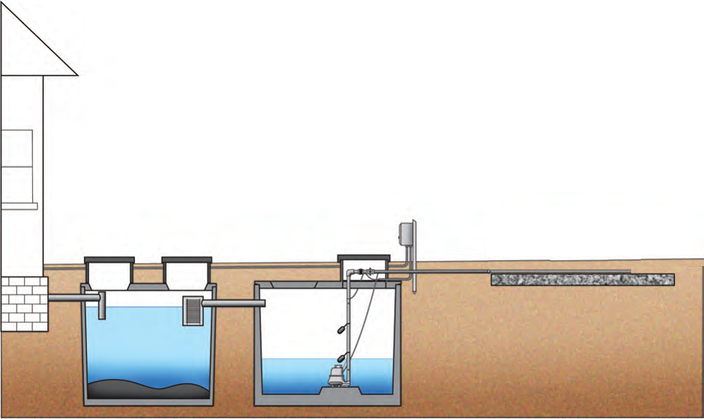
The layout of a standard pressure bed system.

Slide 5
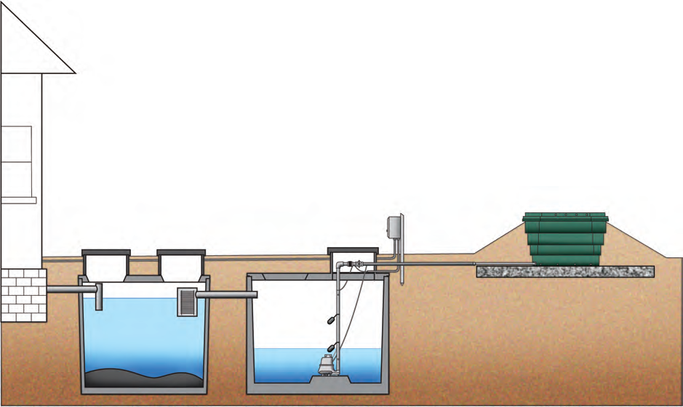
To convert to a bottom draining peat filter pretreatment system we simply insert a peat filter on top of the chosen drainfield (pressure bed, at-grade or mound).

Slide 6
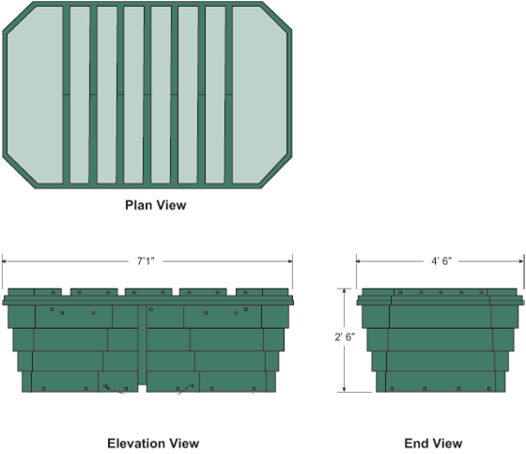
Each pod is approximately 7’ long by 2.5’ high by 4.5’ wide and weighs about 1800 lbs (dry)

Slide 7
Basic components and specifications for the Anua Puraflo bottom draining peat filter
- Septic tank with effluent filter
- Lift tank with Time dosing to the peat filter
- 150 gpd peat filter pods.
- Treatment level B, 18” of separation req’d, and no UV.
- Mound, at-grade & bed dispersal options

Slide 8
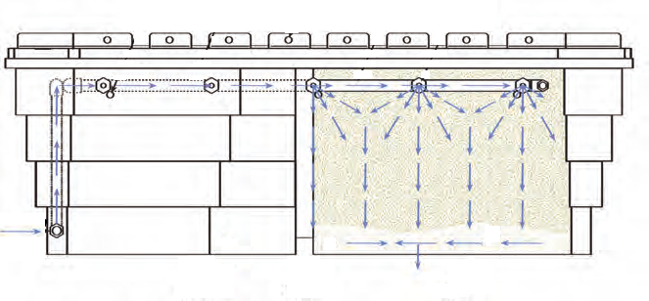
Treatment process
The effluent is micro-dosed to the peat filter by a time dosed control panel.
The effluent is treated as it percolates down through the Peat material.
It then drains out the bottom of the pod and into the underlying rockbed for final soil dispersal.

Slide 9
Different pod configurations for various uses Noted by a painted circle or triangle on the lid: Blue = bottom draining discharge holes. Green = same as Blue, only now ½ the pod is collected and drains to a sampling chamber. Note: MN product registration states that 1 green pod for sampling is req’d on every system, however code does not require sampling so…? Check with your LUG for proper procedures on this item. White = no discharge holes, all of the pod is collected and drains to a pump tank for dispersal elsewhere.

Slide 10
Design specifications
- When mfg design criteria is unclear, MN7080 prevails.
- Hydraulic loading rate – 150 gpd residential strength waste
- Organic loading rate - .375 lbs BOD/day
- Septic tank size: design flow / .9 (minimum), or at least 1 days retention
time (50% larger septic tank if site contains a garbage disposal).
Septic tank to include an effluent filter with 1/32” holes
(zabel A300, polylok PL-625, simtech pressure STF-100)
- Lift tank size: design flow / .9 (minimum)
Realistic recommendation:
Surge volume of ½ days flow,
Reserve volume ¼ days flow.
This leads to about a 1000 gallon tank for 3-4 bedroom system.

Slide 11
Design specifications - continued
- Time dosing:
approximately 12 times per day,
at approximately 10 gpm per pod,
at 15 gal per dose (maximum) per pod.
(3 bedroom = 3 pods, 450 gpd / 12 doses = 37.5 gal dose at 30 gpm for entire system, this is equal to a 1.25 min ON time)
- Bottom draining “pad” system (at-grade or mound style)
Limited to sites with less than 10% slopes.
If slope >10% you must use a collected drainage system.
- The lids are insulated for frost protection, make sure to maintain proper
drainback of the supply line to avoid freezing issues.

Slide 12
Design specifications - continued
- When using bottom draining pods for dispersal directly to a drainfield
rockbed, you will often need more than 1 pod per bedroom.
- Maximum pod separation is 5’, or stated another way, each pod is worth
12’ of rockbed length (mounds & at-grades).
- # of bedrooms * 12 = total system rockbed length (mounds & at-grades).
- The pod can treat up to 150 gpd, but rarely can it evenly disperse 150 gpd.
For a mound or at-grade application:
the contour loading rate * 12’ = gpd the pod can disperse.
(48 - 144 gpd)
For a bed application:
114 ft² * level B soil loading rate = gpd the pod can disperse.
(68 - 150 gpd)

Slide 13
Design specifications - mounds
Each pod gets credited for a maximum length of 12’ of rockbed along the
contour, pods to be evenly spaced with a maximum of 5’ between pods.
Contour Loading Rate * 12’ = design flow per pod.
(typically 12 gpd/ft * 12’ = 144 gpd)
Design flow per pod/1.6 SLR (treatment level B) = rockbed area per pod.
(typically 144 gpd / 1.6 g/ft2 = 90 ft² → 12’ long by 7.5’ wide rockbed)
12” minimum sand lift.

Slide 14
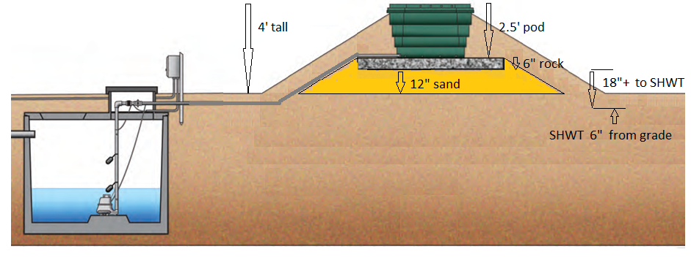
Mound elevation - minimum 4’ tall with minimum 12” sand lift (6” to SHWT) - maximum 4.5’ tall with 18” sand lift (0” to SHWT)

Slide 15
Design specifications - At-grade
Each pod gets credited for a maximum length of 12’ of rockbed along the contour, pods to be evenly spaced with a maximum of 5’ between pods.
Contour Loading Rate * 12’ = design flow per pod.
(typically 4 to 8 gpd/ft * 12’ = 48 to 96 gpd)
Design flow per pod / SLR (treatment level B) = rockbed area per pod.
Range:
hi: sand CLR 8, 96 gpd / 1.6 gpd/ft² = 60 ft² → 12’ L * 5.0’ W
med: sandy loam CLR 6, 72 gpd / 1.0 gpd/ft² = 72 ft² → 12’ L * 6.0’ W
low: clay loam CLR 4, 48 gpd / 0.6 gpd/ft² = 80 ft² → 12’ L * 6.6’ W
For at-grades with slopes >1%, the absorption area is measured from the
downslope side of the pod.
Extra rock upslope may be needed to set the pod on.

Slide 16
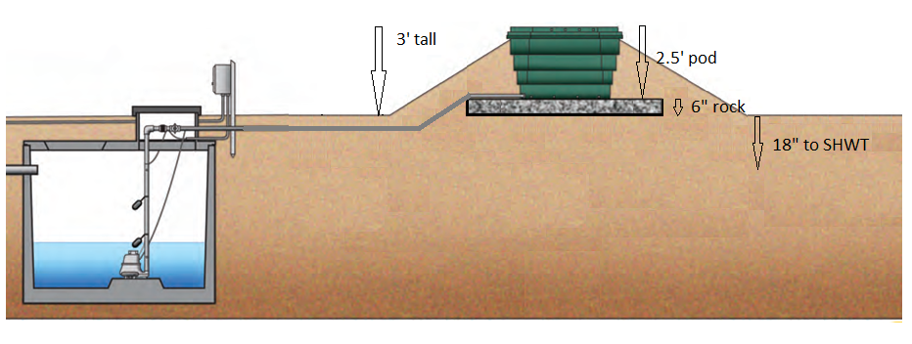
At-grade elevation 3’ tall with 18”+ to SHWT

Slide 17
Design specifications - beds
Each pod gets credited for a maximum of 114 sqr ft of rockbed, pods to be evenly spaced with a maximum of 5’ between pods spaced either end to end or side to side.
Given a 2.5’ perimeter around the pod this leads to a dispersal area
12’ long by 9.5’ wide = 114 ft².
This area multiplied by the Soil Loading Rate gives the design flow dispersal ability of each pod.
Example:
A loam soil with a treatment level B soil loading rate of .78 gpd/ft² would lead to 114 ft² * .78 gpd/ft² = 89 gpd of design flow per pod (not 150 gpd).
For floatation purposes, the maximum burial depth from original grade is about 18”. Under normal “bottom draining” circumstances you would never bury it more than 6-12” anyway.

Slide 18
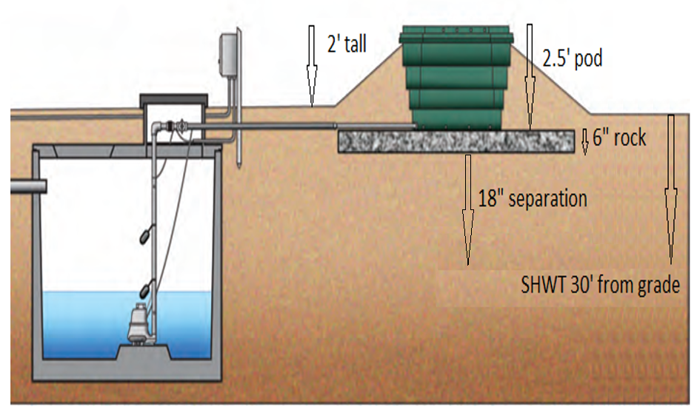
Bed elevation maximum 2.5’ tall with 24” to SHWT 2’ tall with 30” to SHWT minimum 1.5’ tall with 36” to SHWT

Slide 19
Design worksheet
When designing any system, the simplest method is to find the appropriate design worksheet at www.SepticResource.com and fill it in with the basic field data you obtained from your site evaluation. The design worksheet for a pretreatment system will still only take a couple of minutes to complete.
 | 2011 purple code |  |  | Puraflo peat filter |  |  |  |  |  |  |  |  | www.SepticResource.com (vers 14.2)
 |  | Property Owner: |  |  |  |  |  |  |  |  | Date:
 |  | Site Address: |  |  |  |  |  |  |  |  | PID:
 |  | Comments:
 |  | instructions: |  |  | = site specific input |  |  |  | = adjust if desired |  |  |  | = self-calculated (DO NOT ADJUST)
1) |  | ? | bedroom |  | Type | IV |  | Residential |  |  | System
2) |  | 0 | GPD design flow |  |  | (average flow should be < 70% of design flow)
 |  |  | PRETREATMENT: |  |  | (Residential strength to level A/B)
3) |  | 1000 | Gallon Trash trap/pump tank to Multi-flow
4) |  | 500 | Gallon Multi-flow unit |  |  |  | UV light req'd |  | Yes
 |  | 30 | gpm | 10 | ft head TREATMENT pump |  |  |  |  | 48 | doses per day |  |  | 0.0 | gal /dose (treatment)
5) |  | 10 | feet of |  | 2.0 | inch supply line |  |  | leads to | 2 | gallons of drainback volume
 |  |  |  |  |  |  |  |  |  | 2.0 | gallons total pump out volume

Slide 20
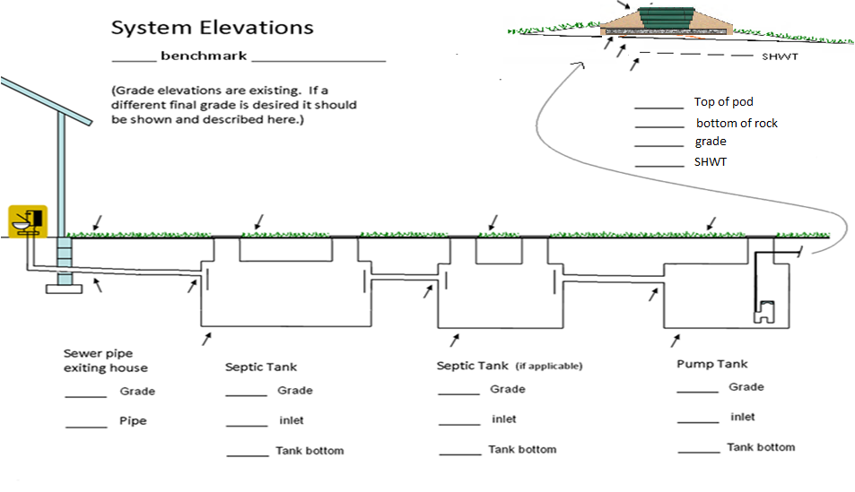
The design sheet will also produce a System elevation template

Slide 21
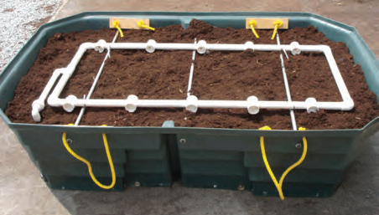
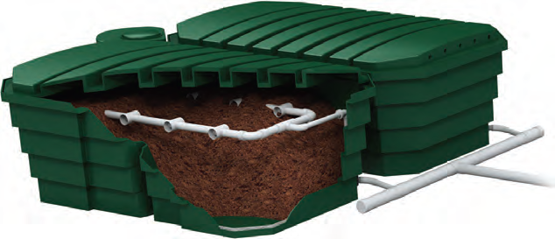
Peat filter distribution/lateral configuration
- The Pod inlet is at the base and is fed upwards to the distribution laterals.
- The Air vents are on the top sides of the lid.
Flow splitting between pods occurs from the pressure equalizing orifice plate in
the union at the inlet of each pod. The laterals are actually more of a “pump to
gravity” distribution system. The first “perf” is the ½” orifice at the pod inlet,
this creates equal pressure between pods, this single large perf then feeds the
entire loop lateral system which also contains ½” holes.

Slide 22
Pod Installation (all types)
- Scarify soil surface as you normally would any other system.
- (For mounds only) apply the appropriate sand lift to obtain adequate
separation to SHWT, minimum of 12”.
(remember only 18” of separation is needed
- Apply 6” of drainfield rock
- Set pod(s) on rockbed, evenly spaced, and perfectly flat These pods are
heavy and will settle awkwardly if not dealt with accordingly. Compact and
rake the rockbed to ensure it is flat.
- Connect 2” force main to pods with flex pipe, 1% slope drainback.
- If LUG req’d, one pod per system is to contain a sampling chamber (green
coded pod). ½ of the pod drain holes are plugged and is diverted into a
“bucket” with access via a small riser to grade. Overflow holes near the top
of the “bucket” allow it to drain as needed to the rockbed.

Slide 23
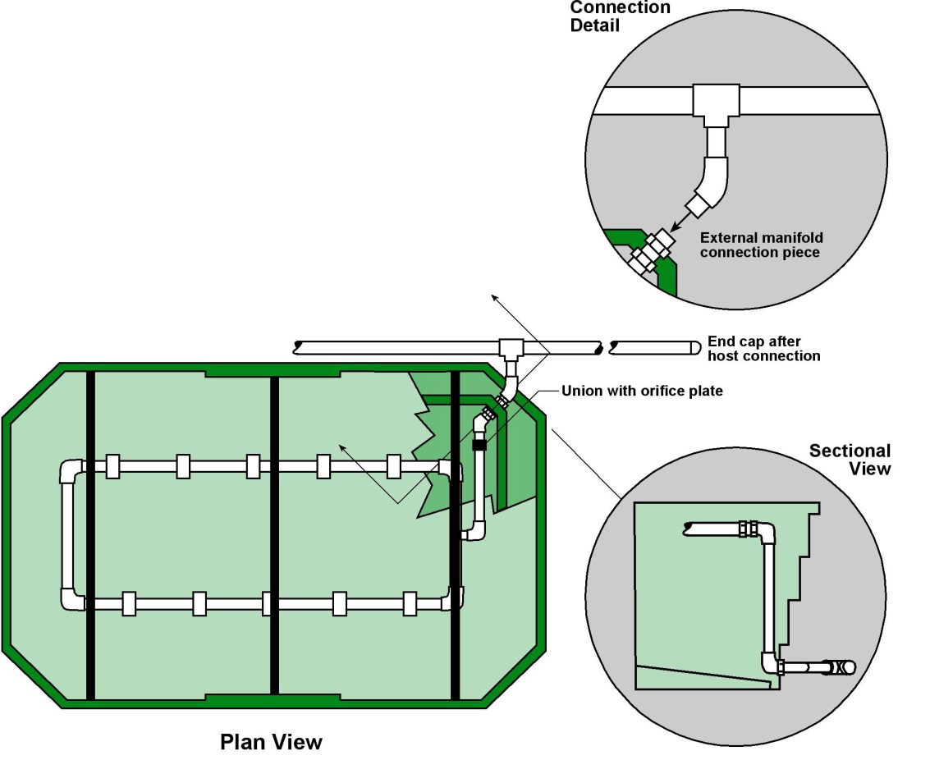
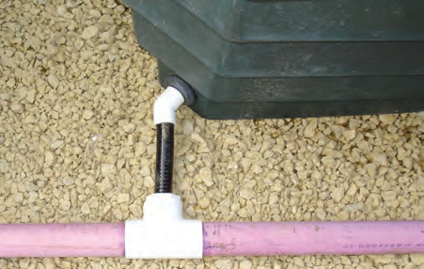
Pod and manifold connection (all types)

Slide 24
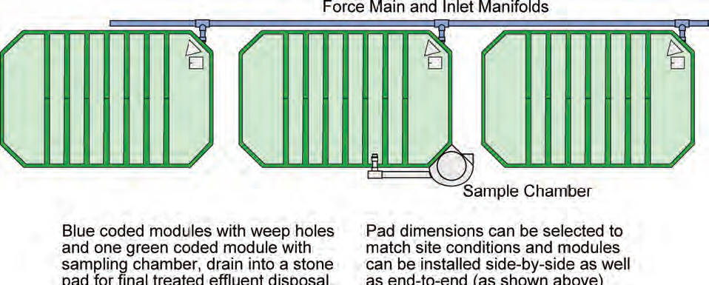
Force main to extend 6” past last pod and be capped. (recommend a cleanout brought to grade)

Slide 25
Pod installation - continued (all types)
- Backfill around pod with 6” of rock to cover supply pipe and pod drain holes.
- Cover rock with geotextile fabric.
- Backfill as normal to just below insulated lid, sloped to divert water away
from pods.

Slide 26
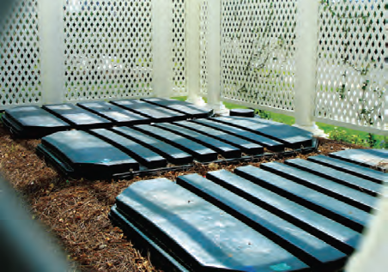
Proper back fill height (to the bottom of the lid)

Slide 27
System summary
The Peat filter pods are registered to treat 150 gpd each, but for bottom
draining distribution the design flow is often less. Most likely you will need
more than 1 pod per bedroom.
The septic tank is sized as you would a normal system and is required to
contain an effluent filter.
The pump tank is time dosed so leave room for surges. A 1000 gallon tank is
typical for a 3-4 bedroom application.
- No UV lite is required.
The peat material will last about 15 years before it needs replacement.
The old media disposed per MN7080.2500 standard abandonment procedures.

Slide 28
System summary - continued
MN7080 requires “treatment level B” effluent to be:
- uniformly distributed, and
- time dosed for all soils except clay and clay loam.
The time dosing pressure distribution to the pods meets both these requirements.
You must be at least an Intermediate designer to design a residential strength Type IV pretreatment system < 2500 gpd.
An operating permit and a management plan are also required.

Slide 29
Components blended in with the natural landscape

Slide 30
This concludes the basic Puraflo peat filter “need to know” training.
For further information contact your local distributor or the manufacturer at www.anuainternational.com

